Slide 1
AI Specialist Capstone project
Notes:
Download the latest version of this compendium here: https://w3.ibm.com/services/lighthouse/documents/120180

Slide 2
OBJECTIVE
This capstone project is your opportunity to move beyond theory and apply AI in a real development workflow. You will leverage Agentic IDEs (such as IBM BOB) to implement backend solution for an eCommerce application - just like in modern AI-powered engineering teams.
By the end, you won’t just understand AI-assisted development - you’ll be able to demonstrate it. Remember to focus not just on the outcome, but on how you leverage AI to think, build, and solve problems differently.
Follow these steps:
Get an access to IBM BOB (fill in this form) (you can also use another Agentic IDE such as AWS Kiro)
Install the IDE on your local setup (Bob installation guidelines)
Go through the use case from Slide 3 to Slide 11
Complete the activities listed on Slide 12
Join the slack channel #applied-ai-specialist-capstone-project for any peer or SME help
Note: Any software installed for development can be removed post the development

Slide 3
USE CASE : An E-Commerce platform to view , browse , purchase books
Description of use case : An online store where a customer can browse , select and buy the selected products
The following are the customer journeys
E-store Home |  |  |  | Catalogue |  |  |  | Payment & Purchase confirmation
1 |  | Login Page |  | 5 |  | Select the Category of products |  | 9 |  | Select the address for delivery
2 |  | User Authtentication User Browses Order History with Buy In Again feature Recommends items based on Order History |  | 6 |  | Browse the brands |  | 10 |  | Initiate payment with the right option Redeem gift points
3 |  | Access Product catalogue for each category |  | 7 |  | Select the product (product tagged with tentative delivery date) Related products appear for selection |  | 11 |  | Payment confirmation
 |  |  |  | 8 |  | Add the product(s) to basket |  | 12 |  | Confirmation on purchase Cancel Order Within 48 hrs

Slide 4
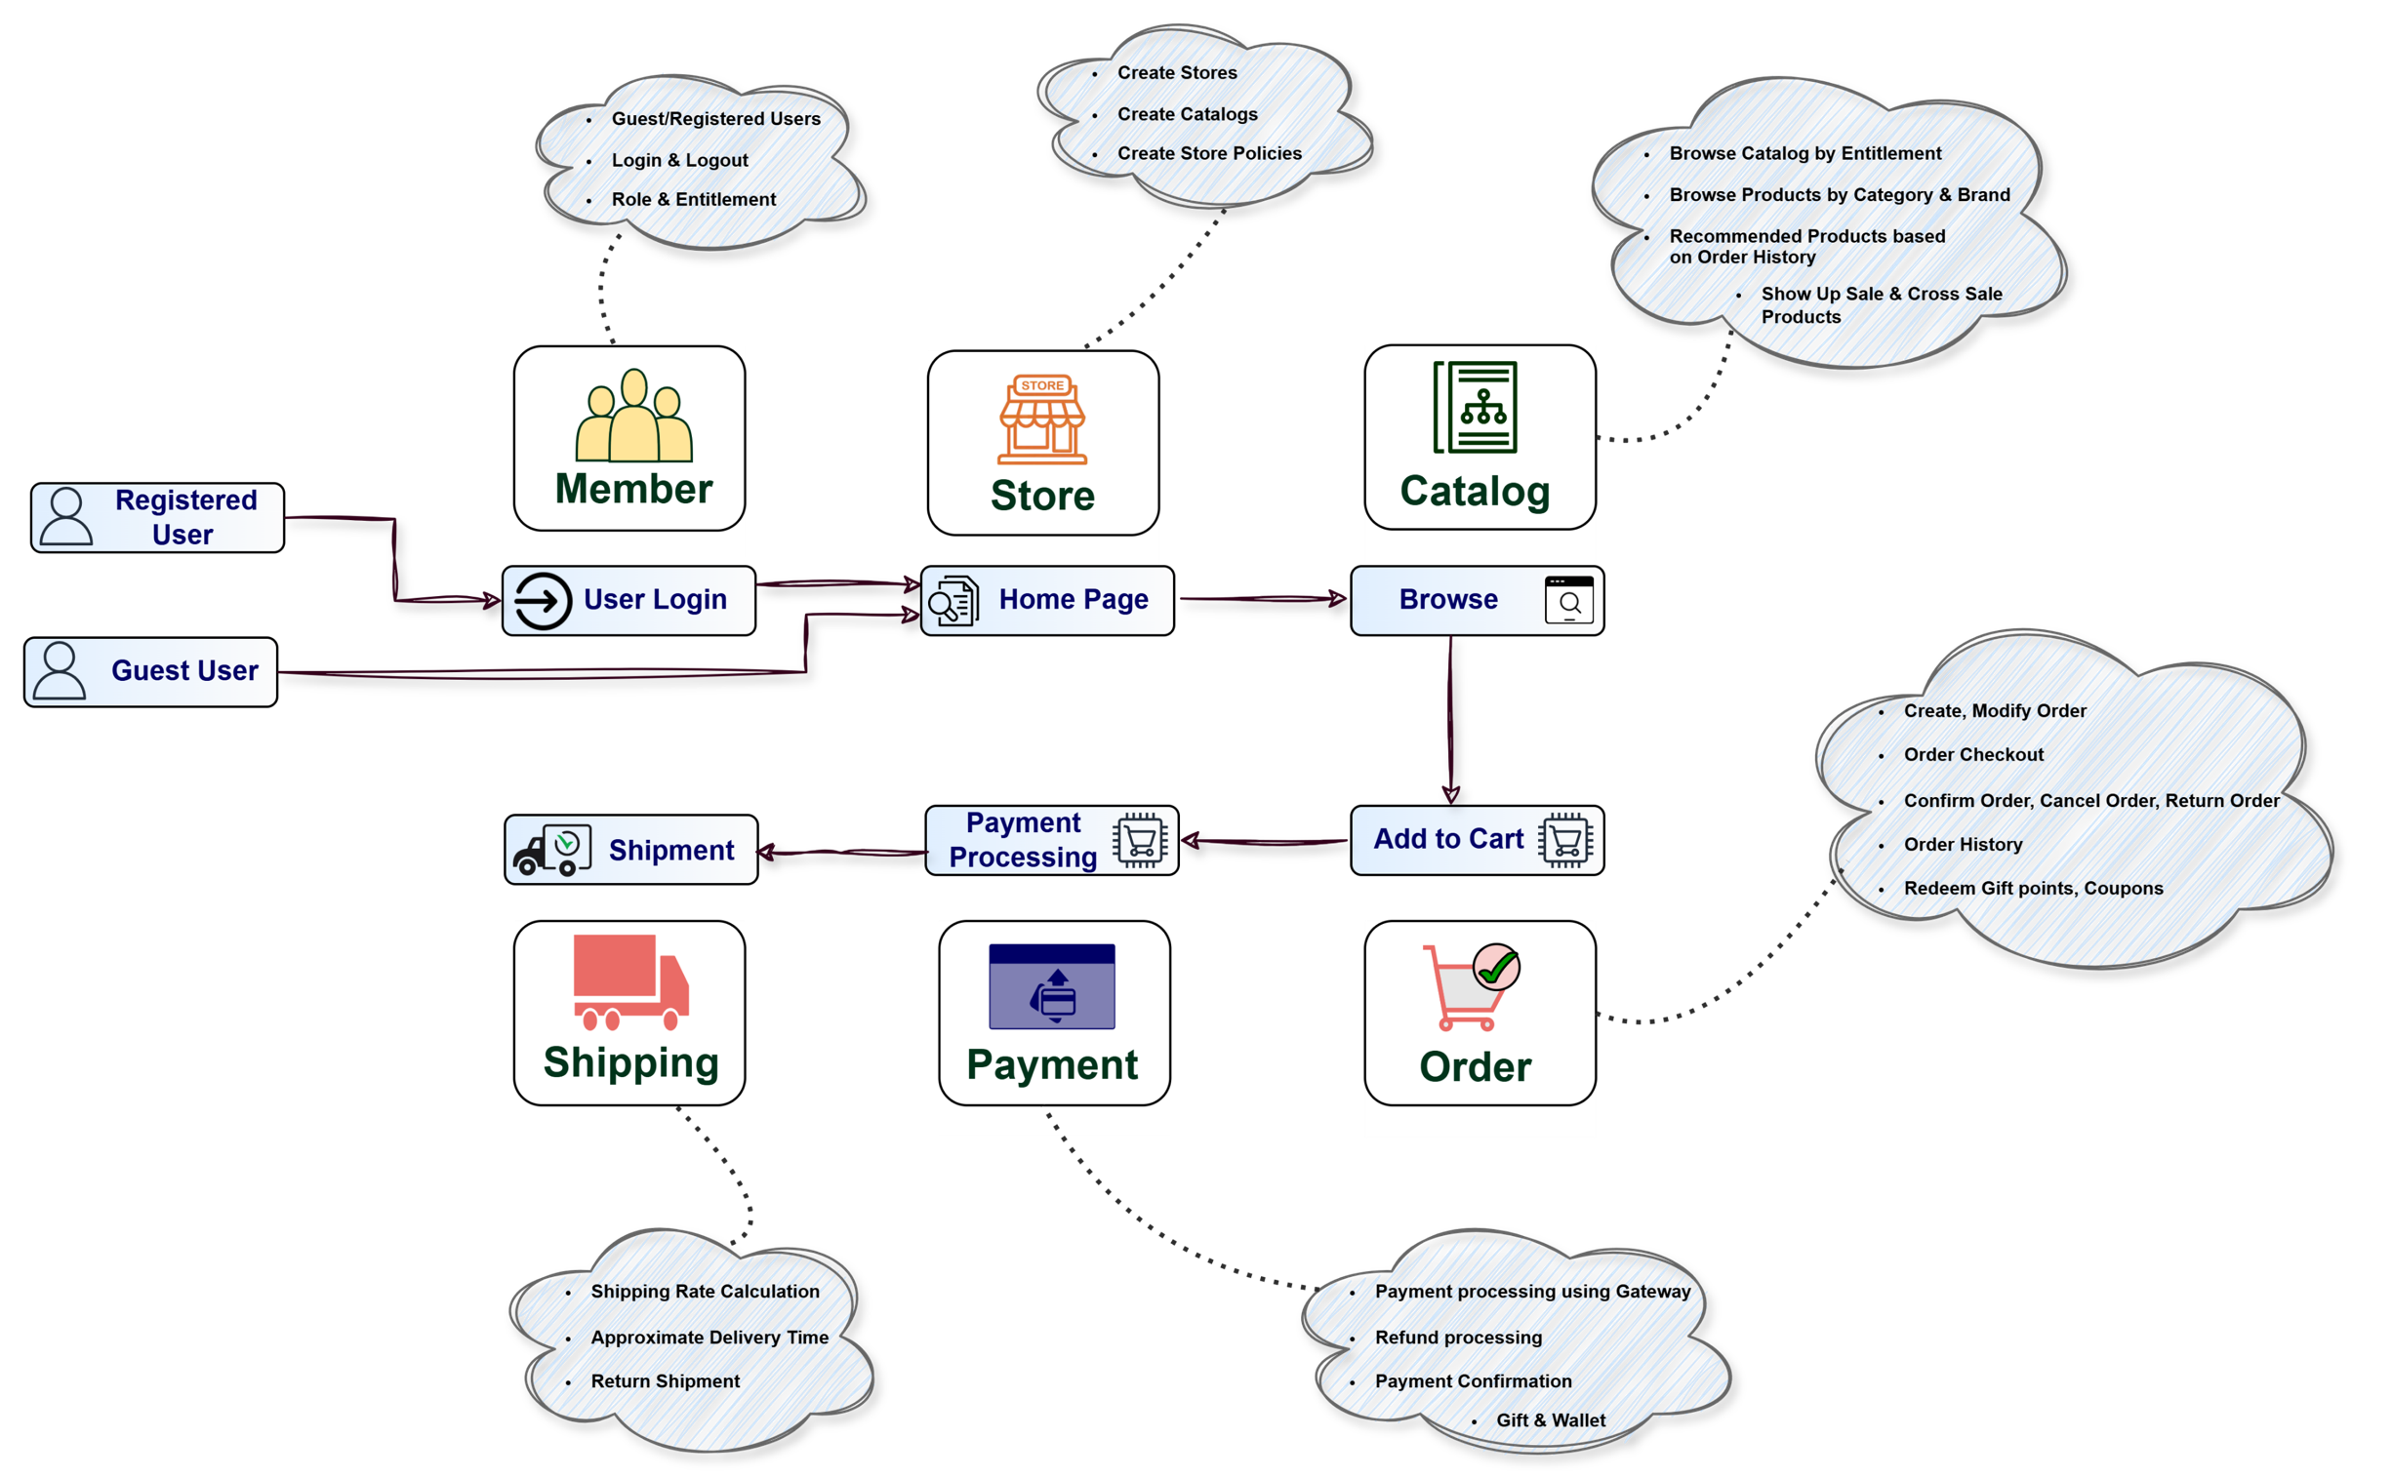
Architecture

Slide 5

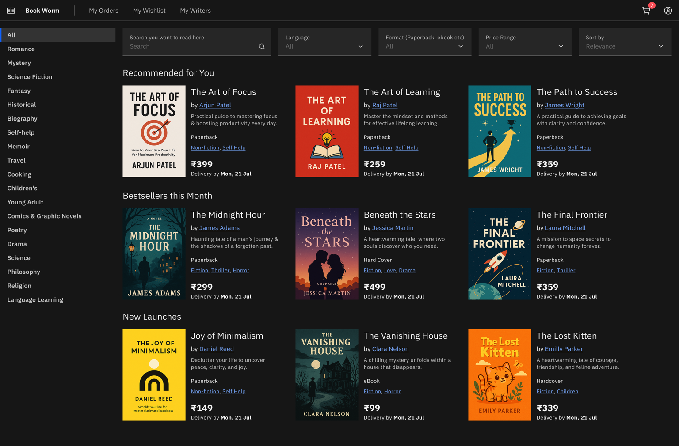
E-Bookstore Platform to be build with agentic IDE
The following demonstrates an e-bookstore platform with the following characteristics:-
Landing page with the availability of books
Selection of books
Buy the books and commit a payment
** The further slides will depict the build of the platform **

Slide 6


The Catalogue page of the e-bookstore is depicted as follows
Key features:
Select the Category of products
Access Product catalogue for each category
Browse the brands
Select the product
Related products appear for selection
User Browses Order History with Buy In Again feature
Footer

Slide 7
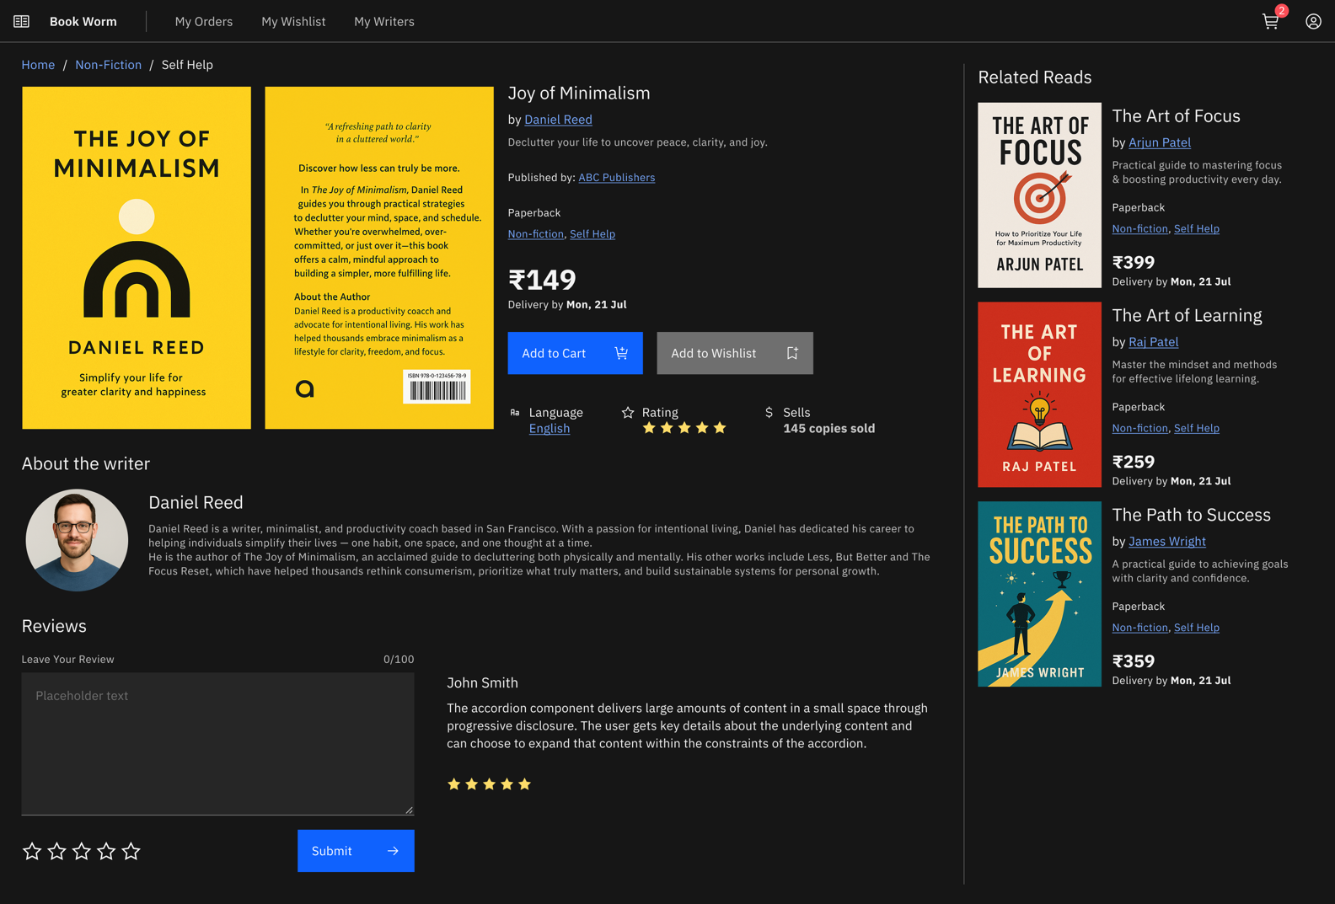
The following provides the Shopping Cart for update
Add the product(s) to basket
Recommends items based on Order History
Footer

Slide 8
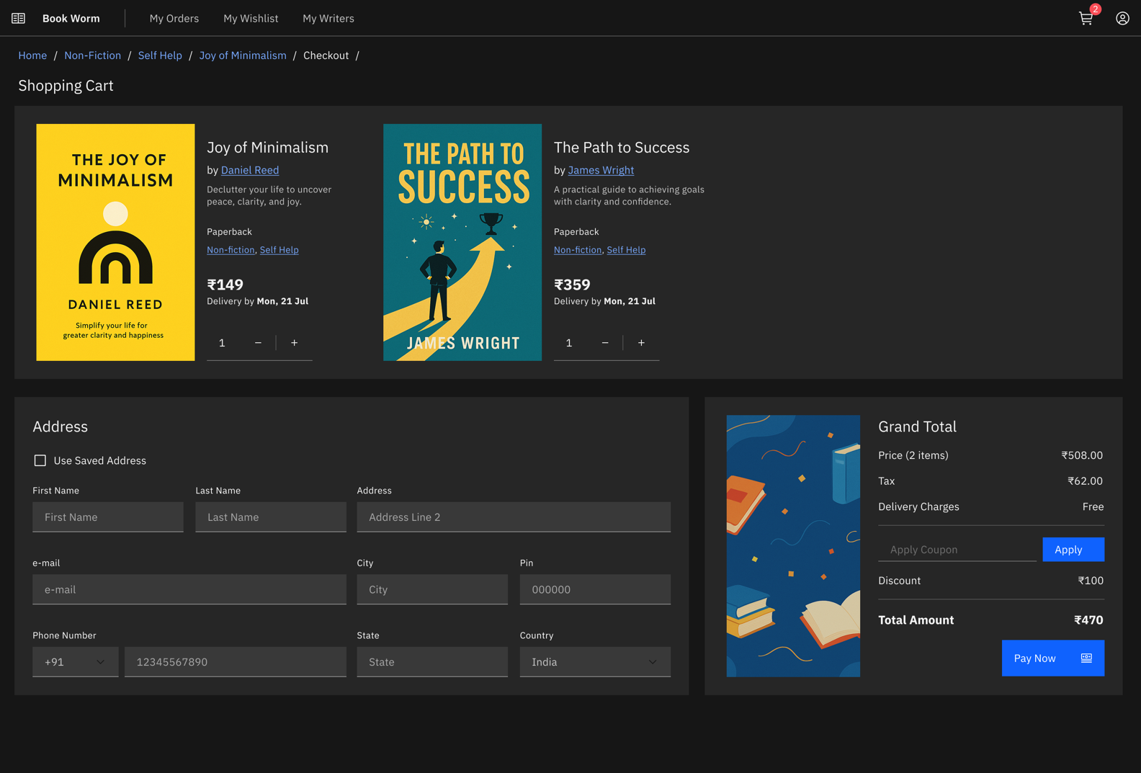
Payment & Purchase
Select the address for delivery
Initiate payment with the right option
Redeem gift points
Footer

Slide 9
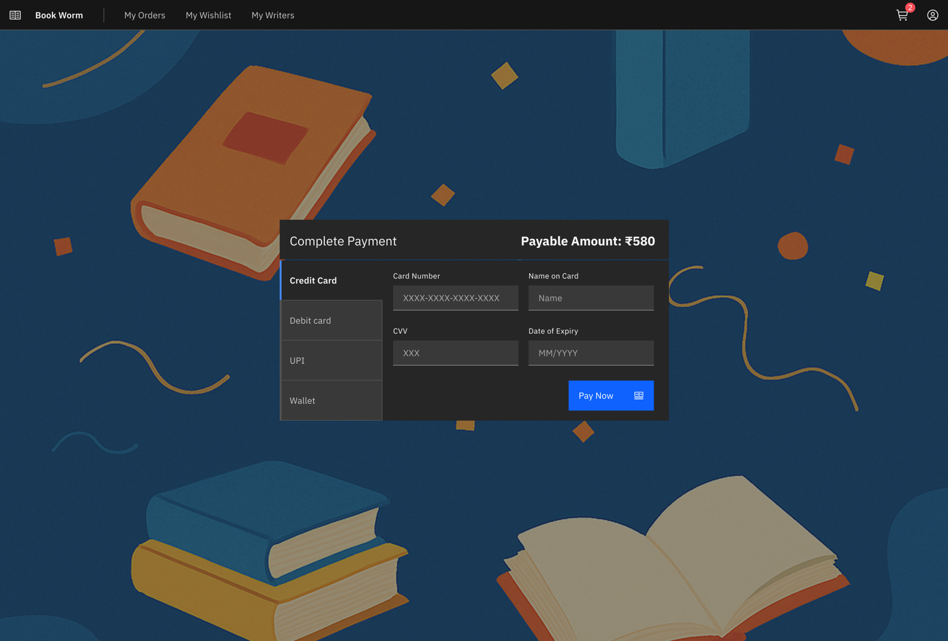
Payment Screen
Initiate payment with the right option (e.g., Credit card, Debit card)
Complete the payment
Footer

Slide 10
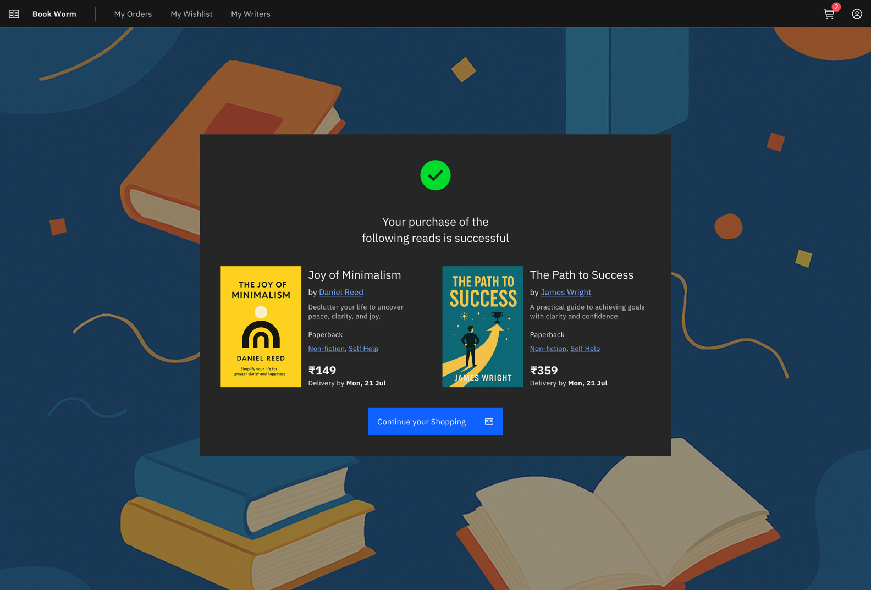
Payment & Purchase
Confirmation on purchase
The message should bring up the purchase completion
Footer

Slide 11
Technology Components and Workflow
Database: PostgreSQL
AI augmentation on UI: Vibe coding with IBM BOB (or AWS KIRO)
Prepare the data model design based on wireframes (Manual)
Open API spec generation
AI augmented backend services: IBM BOB (or AWS KIRO)
AI augmented test case generator: ICA Agent (Choose an agent Ex: Test Scenario Generator, API Testcase generator, Test case generator for React etc..)
Readiness and deployment on a local machine and if you have a cloud environment access (e.g AWS ROSA or IBM ROKS, you can deploy)
PR on your personal GitHub with access provided to your Manager
Record a video describing the steps and submit it to be reviewed by your Manager

Slide 12
Backend API Development Workflow with IBM BOB/KIRO
Step 1: Analyze Wireframe
- Open wireframe documents referred from slide 5- Slide 10
- Identify data entities (Product, User, Order, etc.)
- List required features (search, filter, add to cart, etc.)
Step 2: Open IBM BOB/KIRO
- Launch IBM BOB or KIRO tool
- Start a new session for backend development
Step 3: Generate API Specification
- Upload wireframe to BOB/KIRO
- Ask: "Generate OpenAPI specification for this e-commerce wireframe"
- Specify entities and operations needed
- Review and save the generated API spec
Step 4: Generate Spring Boot Code
- Provide API spec to BOB/KIRO
- Ask: "Generate Spring Boot application with these APIs"
- Specify: Java version, database type (MySQL/H2), dependencies needed
- Download/copy generated code
Step 5: Setup Project Locally
- Extract/organize generated code
- Open in IDE (IntelliJ, VS Code)
- Review project structure (controllers, services, repositories,
entities)
Step 6: Configure Database
Install postgresql community edition from PostgreSQL: Downloads (as per the local OS)
Update application.properties file
- Set database connection details
- Configure port and application name
Step 7: Run Application
- Build project: ./mvn clean install
- Start application: ./mvn spring-boot:run
- Verify application starts without errors
Step 8: Test APIs
- Open an API testing tool like Insomnia or through browser
- Test each endpoint (GET, POST, PUT, DELETE)
- Verify responses match API specification
- Check data is saved in database
Step 9: Git Check-in
- Initialize git: git init (if new project)
- Create feature branch: git checkout -b feature/api-implementation
- Stage files: git add .
- Commit: git commit -m "Implement Spring Boot API for e-commerce"
- Push: git push origin feature/api-implementation
- Create Pull Request with API documentation
Raise any questions through the slack channel:
#applied-ai-specialist-capstone-project

